Slide 1
Foundations of Data Science
Dr. Arpita Nath Boruah
Assistant Professor
Faculty of Computer Technology (CSE)

Slide 2
CONTENTS
Module | Content
1 | Introduction Need for Data Science – What is Data Science - Data Science Process – Business Intelligence and Data Science – Prerequisites for a Data Scientist – Tools and Skills required.
2 | Exploratory Data Analysis (EDA) and Basic Statistical Interface: Exploratory Data Analysis (EDA), statistical measures, Basic tools (plots, graphs and summary statistics) of EDA, Data Analytics Lifecycle, Discovery, Developing Initial Hypotheses, Identifying Potential Data Sources, EDA case study, testing hypotheses on means, proportions and variances, Error metrics
3 | Data Science Methodology: Analytics for Data Science – Examples of Data Analytics, Data Discovery, Data Preparation, Model Planning, Model Building, Communicate Results, Data cleaning - Data integration - Data Reduction - Data Transformation and Data Discretization, Feature Generation and Feature Selection, Feature Selection algorithms: Filters- Wrappers

Slide 3
CONTENTS
Module | Content
4 | Basic Machine Learning Algorithms: Classifiers - Decision tree - Naive Bayes - k-Nearest Neighbors (k-NN), k-means – SVM, Association Rule mining – Ensemble methods
5 | Platform for Data Science Python for Data Science –Python Libraries – Data Frame Manipulation with numpy and pandas – Exploration Data Analysis – Time Series Dataset – Clustering with Python – Dimensionality Reduction. Python integrated Development Environments (IDE) for Data Science.

Slide 4
UNIT 1

Slide 5
Introduction
Data Science is an interdisciplinary field that focuses on extracting knowledge from data sets which are typically huge in amount.
It considers analysis, preparing data for analysis, and presenting findings to inform high-level decisions in an organization.
It incorporates skills from computer science, mathematics, statistics, information visualization, graphic, and business.

Slide 6
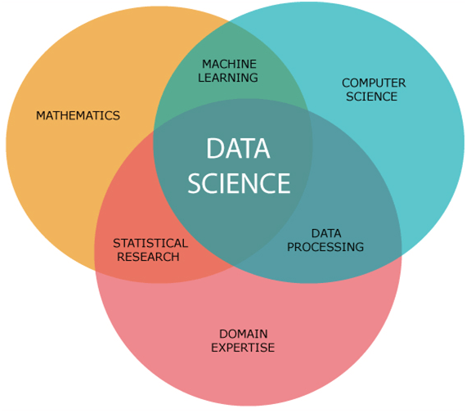

Slide 7
Why Data Science?
Data science plays an important role by helping us to discover useful information from the data, answer questions, and even predict the future or the unknown.
It encompasses a wide range of tasks, including data cleaning and preparation, data visualization, statistical modeling, machine learning, and more.
With the help of data science, companies use Data Mining and sorting techniques to understand the area of interest of their users.
data science is being actively used to trim unstructured and unorganized data that also consumes less time.
It helps in identifying the objective of a business and helps in reaching the goal

Slide 8
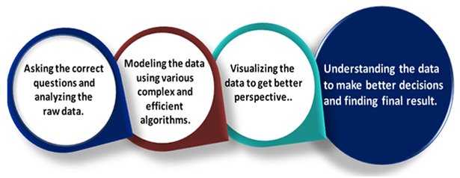

Slide 9
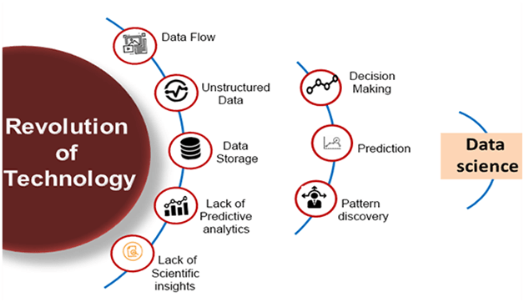

Slide 10
Application of Data Science
Search Engines,
Transport, Finance,
E-Commerce,
Health Care,
Image Recognition,
Targeting recommendations, etc.

Slide 11
Challenges
Multiple Data Source – In companies data comes from multiple different sources handling all this data is a very challenging process. Also, data coming from these sources may not be cleaned or not in a structured format
Irrelevant Data Columns –Irrevalent columns can lead us to a bad performance model or they can cause overfitting.
Computing Resources – Handling millions of rows and thousands of columns requires a large computing source which may not be available on our local computers.

Slide 12
Advantages
Improved decision-making: Data science can help organizations make better decisions by providing insights and predictions based on data analysis.
Cost-effective: With the right tools and techniques, data science can help organizations reduce costs by identifying areas of inefficiency and optimizing processes.
Innovation: Data science can be used to identify new opportunities for innovation and to develop new products and services.
Competitive advantage: Organizations that use data science effectively can gain a competitive advantage by making better decisions, improving efficiency, and identifying new opportunities.
Personalization: Data science can help organizations personalize their products or services to better meet the needs of individual customers.

Slide 13
Disadvantages
Data quality: The accuracy and quality of the data used in data science can have a significant impact on the results obtained.
Privacy concerns: The collection and use of data can raise privacy concerns, particularly if the data is personal or sensitive.
Complexity: Data science can be a complex and technical field that requires specialized skills and expertise.
Bias: Data science algorithms can be biased if the data used to train them is biased, which can lead to inaccurate results.
Interpretation: Interpreting data science results can be challenging, particularly for non-technical stakeholders who may not understand the underlying assumptions and methods used.

Slide 14
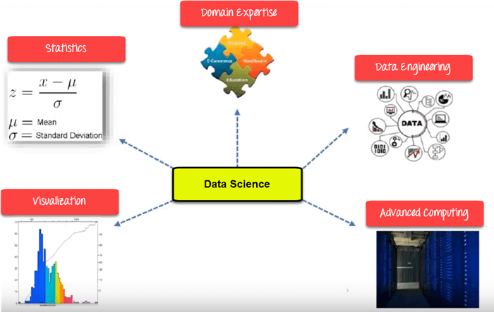
Components of Data Science

Slide 15
Data Science Life Cycle
Business Understanding / Problem Statement
Data Understanding
Preparation of Data / data cleaning
Exploratory Data Analysis / Data Analysis and Exploration
Data Modeling
Model Evaluation
Model Deployment

Slide 16
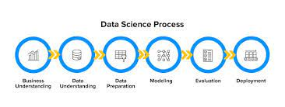

Slide 17
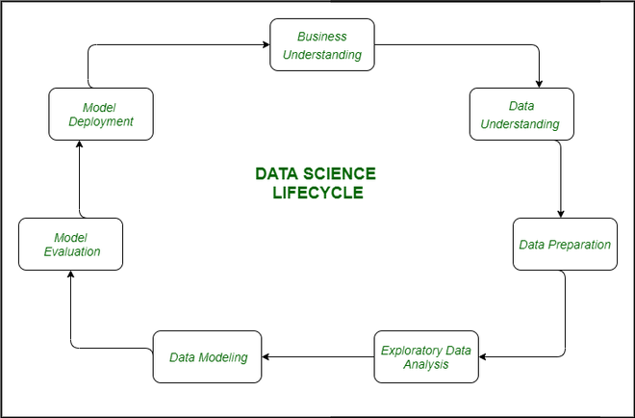

Slide 20
What is business intelligence?
Business Intelligence (BI) is a means of performing descriptive analysis of data using technology and skills to make informed business decisions.
The set of tools used for BI collects, governs, and transforms data.
conversion of raw data into meaningful information which is thus used for business decision-making and profitable actions.
It facilitates decision-making by enabling the sharing of data between internal and external stakeholders.
The most impactful enabler of BI in recent years has been cloud computing
The goal of BI is to derive actionable intelligence from data.
Gaining a better understanding of the market
Uncovering new revenue opportunities
Improving business processes
Staying ahead of competitors

Slide 21
What do data analysts do?
Data analysts gather, clean, analyze, visualize, and present existing data to help inform business decisions.
An effective data analyst uses data to answer a question and empower decision makers to plot the best course of action.
Common tasks for a data analyst might include:
Working with business leaders and stakeholders to define a problem or business need
Identifying and sourcing data
Cleaning and preparing data for analysis
Analyzing data for patterns and trends
Visualizing data to make it easier to understand
Presenting data in such a way that it tells a compelling story

Slide 22
What do business analysts do?
Business analysts help identify problems, opportunities, and solutions for their organizations.
Evaluating a company’s current functions and IT structures
Reviewing processes and interviewing team members to identify areas for improvement
Presenting findings and recommendations to management and other key stakeholders
Creating visuals and financial models to support business decisions
Training and coaching staff in new systems

Slide 23
Skills: Business vs. data analyst
Data analyst | Business analyst
Data analysis | Needs analysis
Statistics | Prototyping
Knowledge of data structures | Knowledge of business structures
SQL and statistical programming | Microsoft Visio and software design tools

Slide 24
Business intelligence is backward-looking that discovers the previous and current trends, while data science is forward-looking and forecasts future trends.
Compared to business intelligence, data science is able to manage more dynamic and less organized data. Yet, it also requires more technical skills and resources.

Slide 25

S. No | Factor | Data Science | Business Intelligence
1. | Concept | It is a field that uses mathematics, statistics and various other tools to discover the hidden patterns in the data. | It is basically a set of technologies, applications and processes that are used by the enterprises for business data analysis.
2. | Focus | It focuses on the future. | It focuses on the past and present.
3. | Data | It deals with both structured as well as unstructured data. | It mainly deals only with structured data.
4. | Flexibility | Data science is much more flexible as data sources can be added as per requirement. | It is less flexible as in case of business intelligence data sources need to be
5. | Method | It makes use of the scientific method. | It makes use of the analytic method.

Slide 26
6. | Complexity | It has a higher complexity in comparison to business intelligence. | It is much simpler when compared to data science.
7. | Expertise | It’s expertise is data scientist. | It’s expertise is the business user.
8. | Questions | It deals with the questions of what will happen and what if. | It deals with the question of what happened.
9. | Storage | The data to be used is disseminated in real-time clusters. | Data warehouse is utilized to hold data.
10. | Integration of data | The ELT (Extract-Load-Transform) process is generally used for the integration of data for data science applications. | The ETL (Extract-Transform-Load) process is generally used for the integration of data for business intelligence applications.

Slide 27
11. | Tools | It’s tools are SAS, BigML, MATLAB, Excel, etc. | It’s tools are InsightSquared Sales Analytics, Klipfolio, ThoughtSpot, Cyfe, TIBCO Spotfire, etc.
12. | Usage | Companies can harness their potential by anticipating the future scenario using data science in order to reduce risk and increase income. | Business Intelligence helps in performing root cause analysis on a failure or to understand the current status.
13. | Business Value | Greater business value is achieved with data science in comparison to business intelligence as it anticipates future events. | Business Intelligence has lesser business value as the extraction process of business value carries out statically by plotting charts and KPIs (Key Performance Indicator).
14. | Handling data sets | The technologies such as Hadoop are available and others are evolving for handling understandingItsItsarge data sets. | The sufficient tools and technologies are not available for handling large data sets.

Slide 28
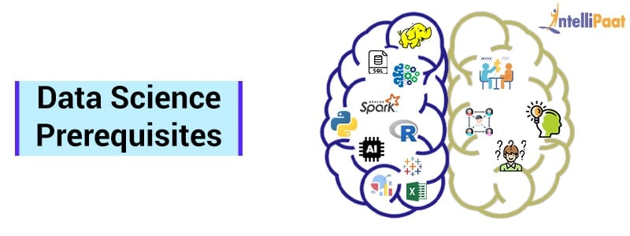

Slide 29
Prerequisites for a Data Scientist
Technical
Non-Technical:
Management Principles
Communication
Data Intuition
Intellectual curiosity

Slide 30
What is Data?
What is Big Data?

Slide 31
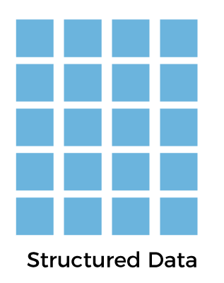
The data which is to the point, factual, and highly organized is referred to as structured data. It is quantitative in nature, i.e., it is related to quantities that means it contains measurable numerical values like numbers, dates, and times.

Slide 32

lacks any predefined model or format.
requires a lot of storage space, and it is hard to maintain security in it.
cannot be presented in a data model or schema.
resides in various different formats like text, images, audio and video files, etc.
It is qualitative in nature

Slide 33
On the basis of | Structured data | Unstructured data
Technology | It is based on a relational database. | It is based on character and binary data.
Flexibility | Structured data is less flexible and schema-dependent. | There is an absence of schema, so it is more flexible.
Scalability | It is hard to scale database schema. | It is more scalable.
Robustness | It is very robust. | It is less robust.
Performance | Here, we can perform a structured query that allows complex joining, so the performance is higher. | While in unstructured data, textual queries are possible, the performance is lower than semi-structured and structured data.
Nature | Structured data is quantitative, i.e., it consists of hard numbers or things that can be counted. | It is qualitative, as it cannot be processed and analyzed using conventional tools.
Format | It has a predefined format. | It has a variety of formats, i.e., it comes in a variety of shapes and sizes.
Analysis | It is easy to search. | Searching for unstructured data is more difficult.

Slide 34
Class work
Prepare a worksheet to practice collecting, organizing, and working with data. generate a data collection question, collect the data, and then work with it including mean, median, mode.
Prepare question set of collection data of your own domain interest
Consider your own assumption for number of rows and columns
Give justification
Analysis the data
Do data preprocessing (manipulation)

Slide 35
Class work
Prepare data set for student
Consider your own assumption for number of rows and columns
Give justification
Analysis the data
Do data preprocessing (manipulation)

Slide 36


